Slide 1
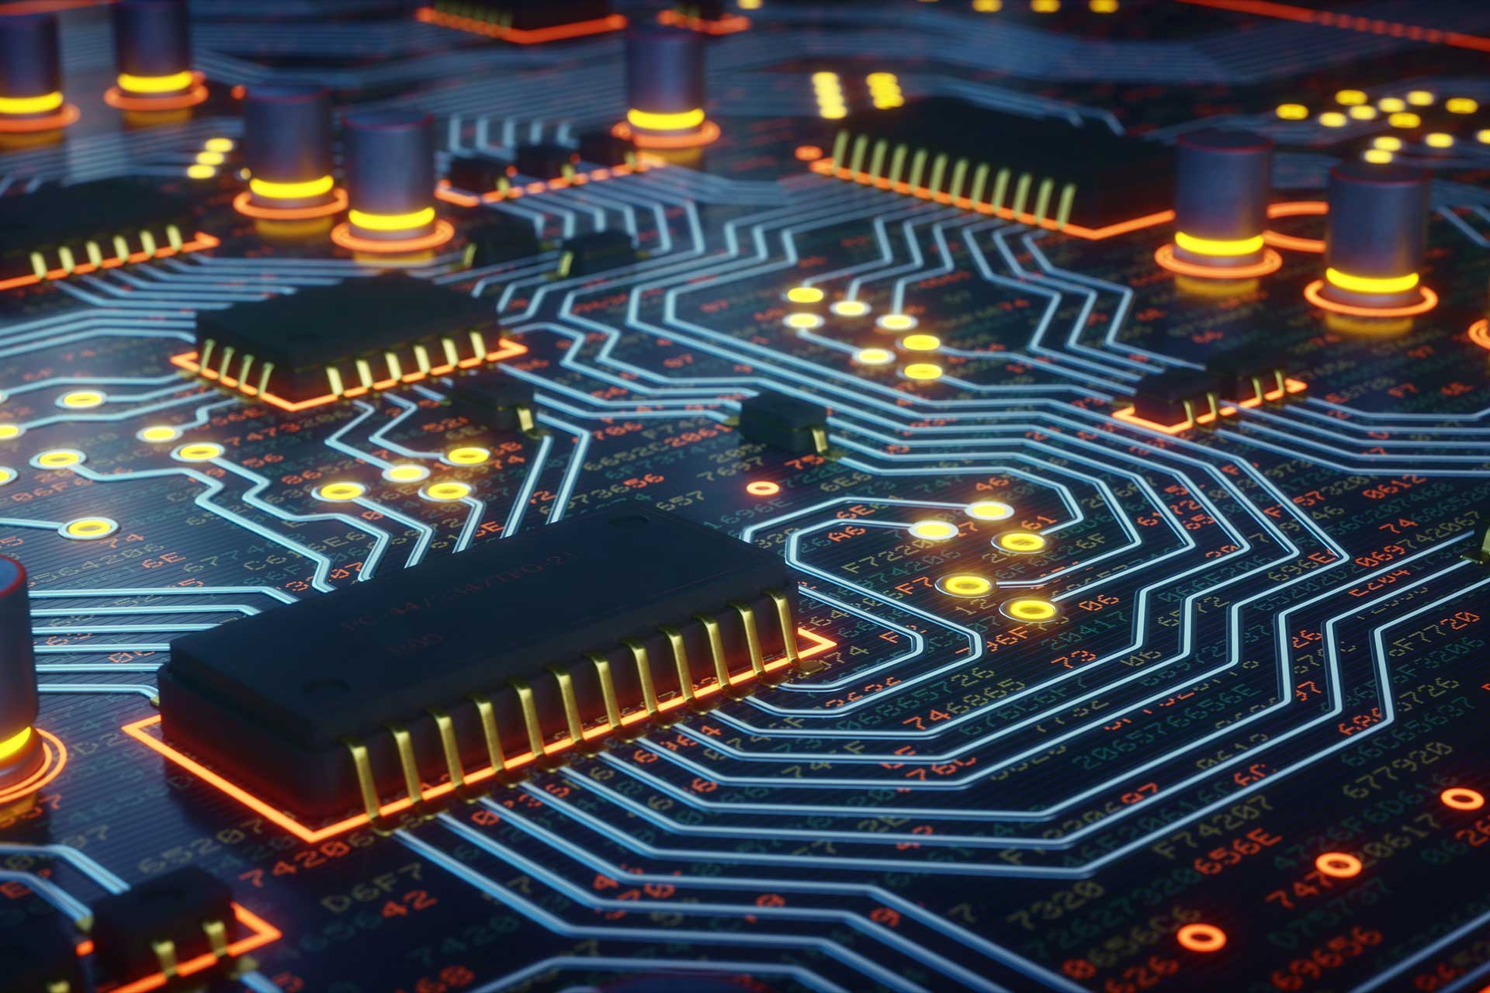
How to Make Almost Everything
Lecture 06
- Electronic Card
Manufacturing (2/2)
Brice PARILUSYAN
PhD Student
brice.parilusyan@gmail.com

Slide 2
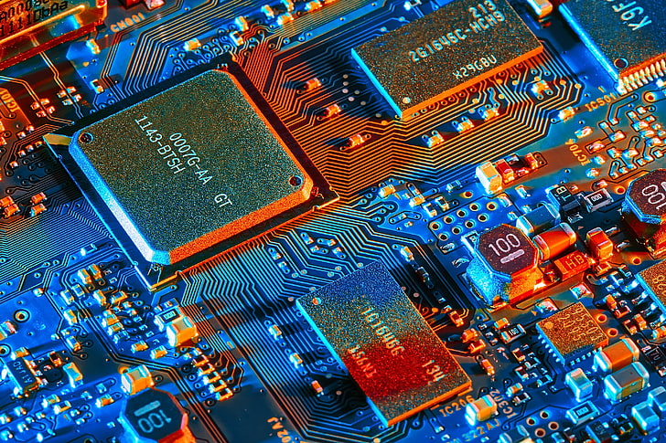
Course overview
01|
Tools
02|
PCB technologies
03|
Circuit design

Slide 3
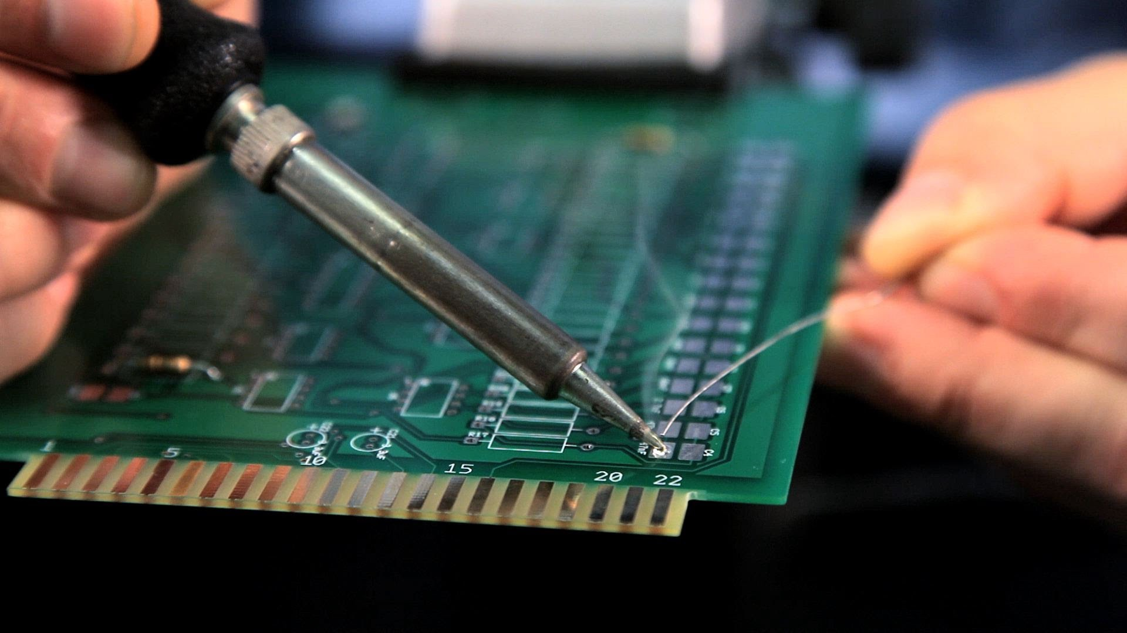
Tools
Electronic tools
Soldering tools

Slide 4
1|
Tools
Electronic tools
Multimeter
Oscilloscope
Power supply
Wave generator

Slide 5
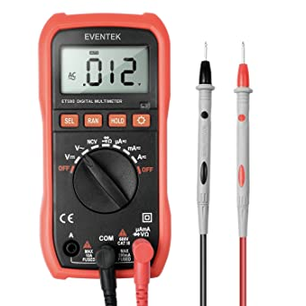
1|
Tools
Multimeter
Definition :
A multimeter is an electronic tool that measures resistance, capacitance, voltage, and intensity. Some of them integrate supplementary modules.

Slide 6
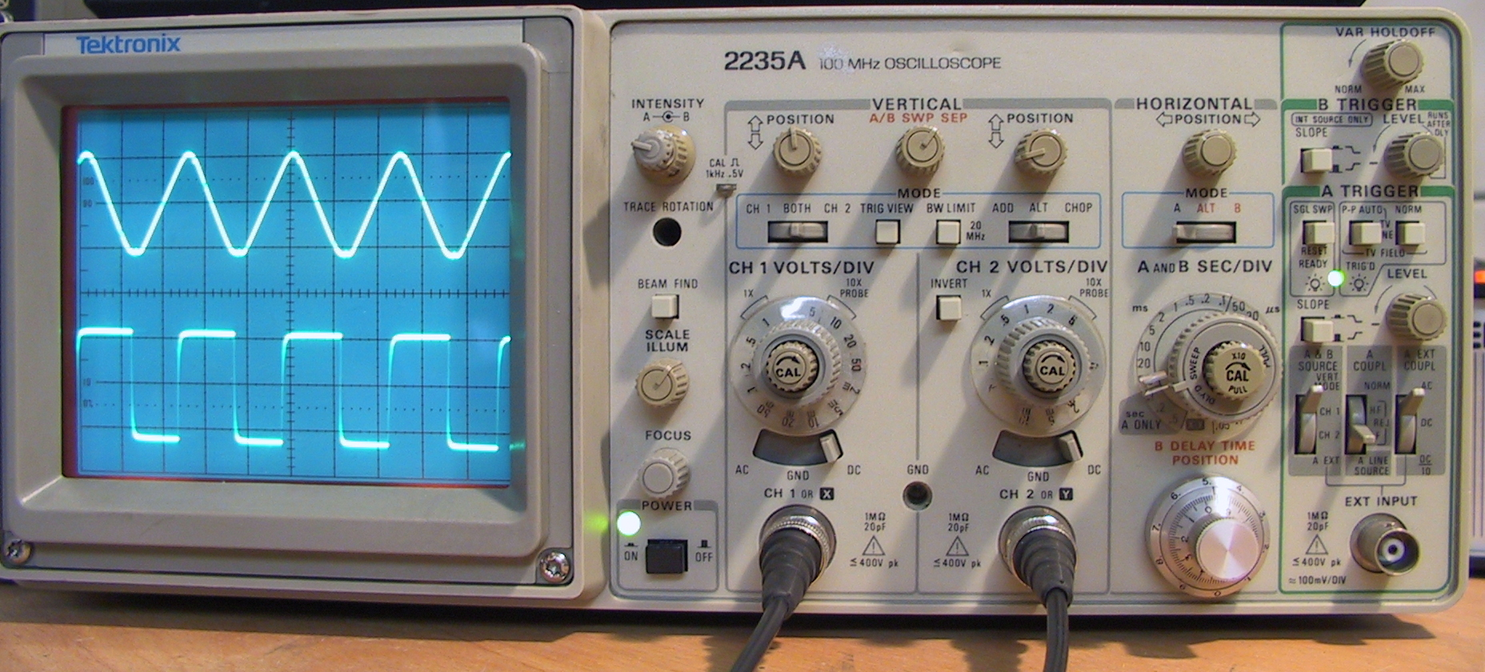
1|
Tools
Oscilloscope
Definition :
An oscilloscope, or oscillograph, is a measuring instrument designed to display an electrical signal, usually variable over time.
A distinction is generally made between analog oscilloscopes that directly use a multiple of the input voltage to produce the spot deviation and digital oscilloscopes that, before any processing, transform the input voltage into a number.

Slide 7
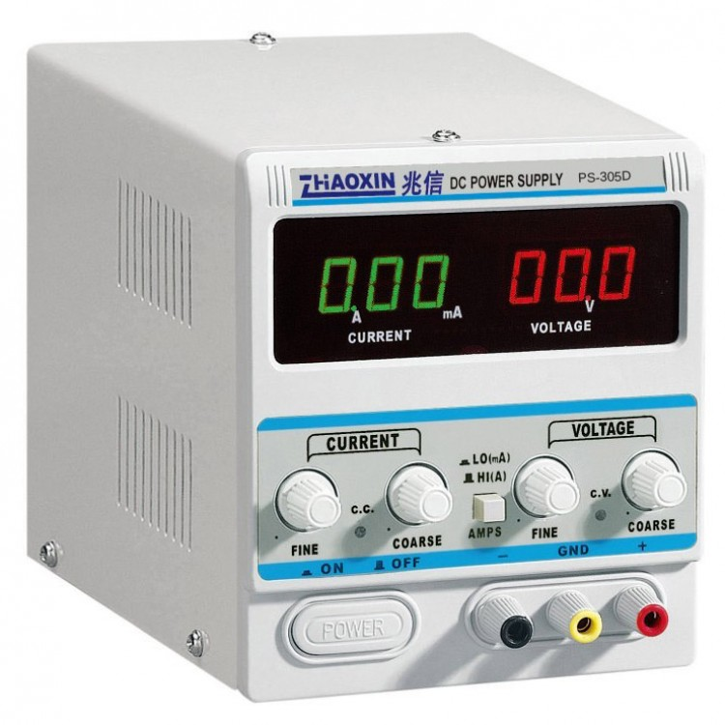
1|
Tools
Power supply
Definition :
A power supply is an electrical device that supplies electric power to an electric load. The primary function of a power supply is to convert current from a source to the correct voltage, current, and frequency to power the load. As a result, power supplies are sometimes referred to as electric power converter.

Slide 8
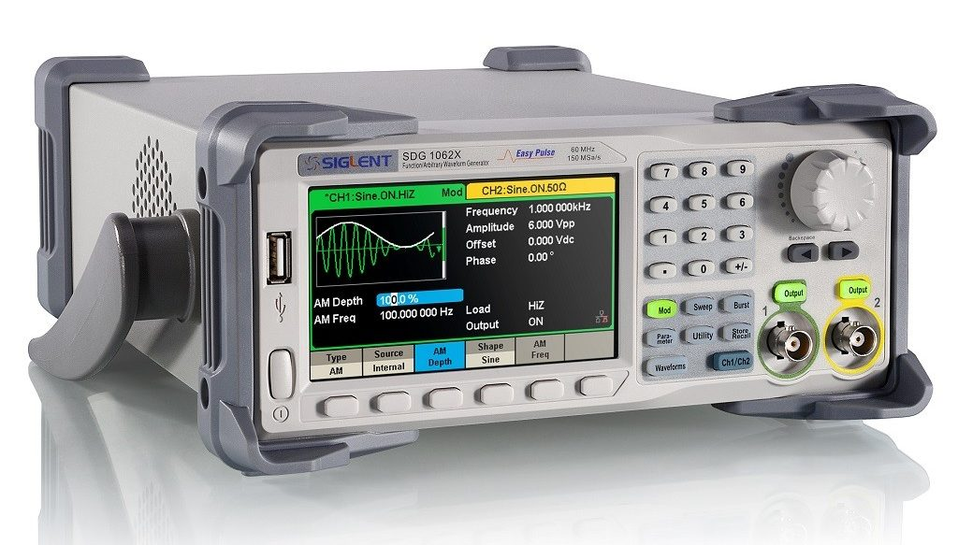
1|
Tools
Wave generator
Definition :
A function generator is usually a piece of electronic equipment or software used to generate different types of electrical waveforms over a wide range of frequencies. Some of the most common waveforms produced by the function generator are the sine wave, square wave, triangular wave, and sawtooth shapes.

Slide 9
1|
Tools
Soldering tools
Iron solder
Soldering accessories
SMD soldering

Slide 10
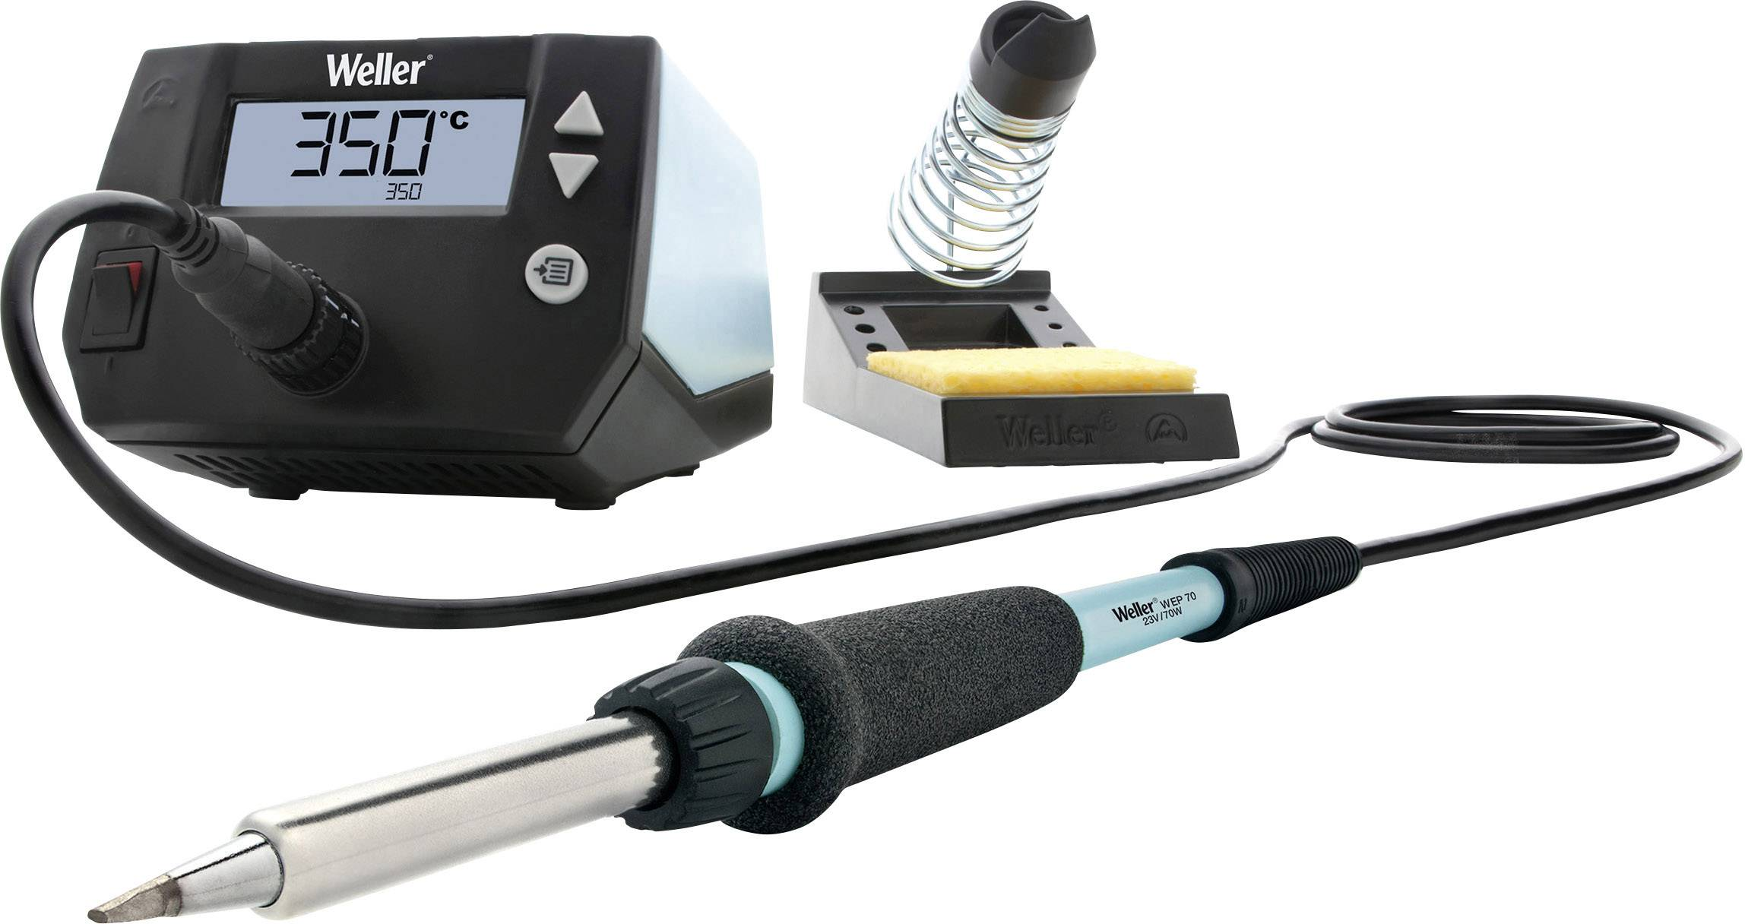
1|
Tools
Iron solder
Definition :
A soldering station is a multipurpose power soldering device designed for electronic components soldering. This type of equipment is mostly used in electronic and electrical engineering.
Soldering and desoldering use different temperatures. It’s important to understand that too high temperatures lead to the destruction of the device.

Slide 11
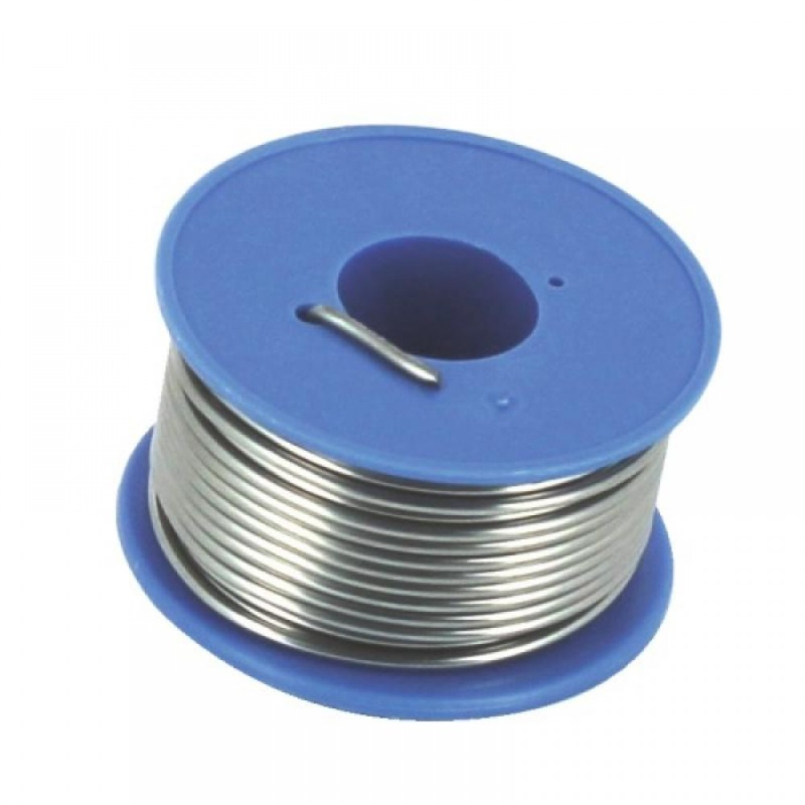
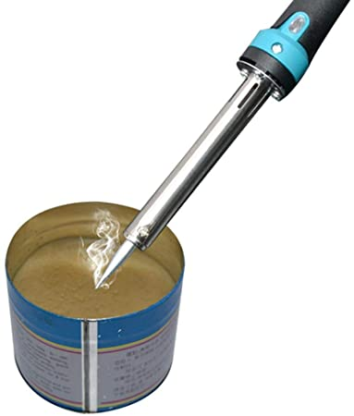
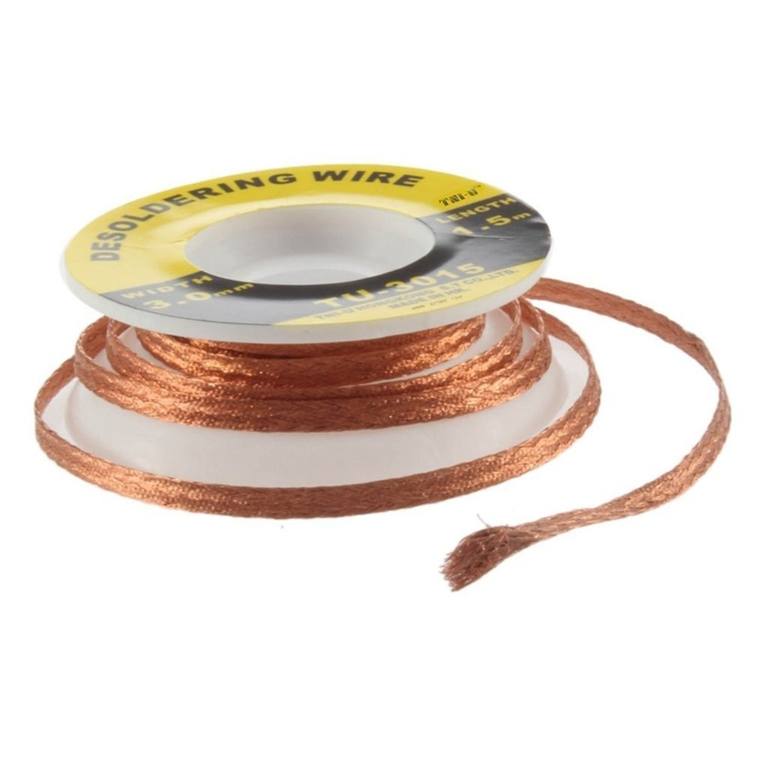
1|
Tools
Soldering accessories
Properties :
Solder tin has different sizes and qualities. Melting temperature around 230°.
Desoldering bread is used to remove the unwanted tin. Better to use it with flux and higher temperatures than normal.
Soldering flux reduces oxidation during soldering and improves it. USE A MASK OR AIR CLEANER AROUND, IT CREATE SMOKE

Slide 12
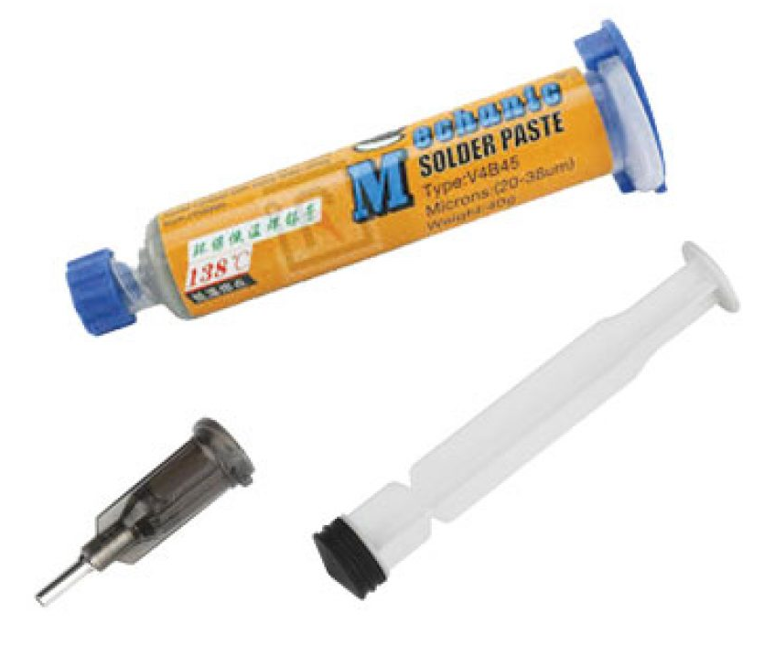
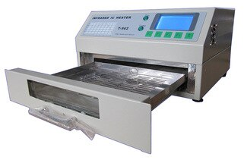
1|
Tools
SMD soldering
Properties :
A Reflux oven is used to bake PCB. Depending on the composition of the solder paste used, you must program a specific baking process
Mask is a metallic sheet with holes corresponding with the soldering points of the PCB. It is used to spray correctly soldering paste on the PCB

Slide 13
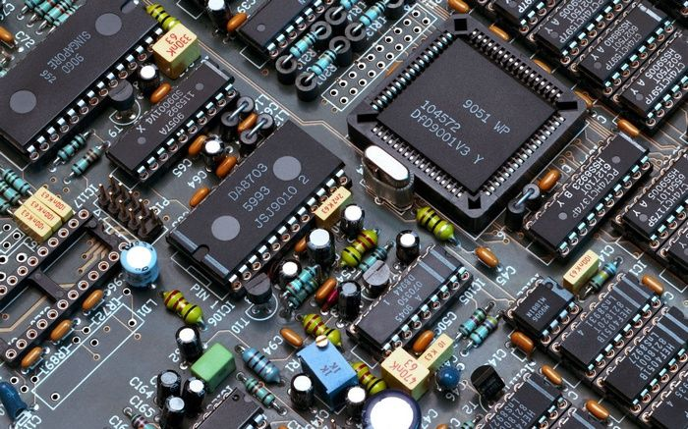
PCB technologies
THT
SMD

Slide 14
2|
PCB technologies
THT
Description
Soldering
Desoldering

Slide 15
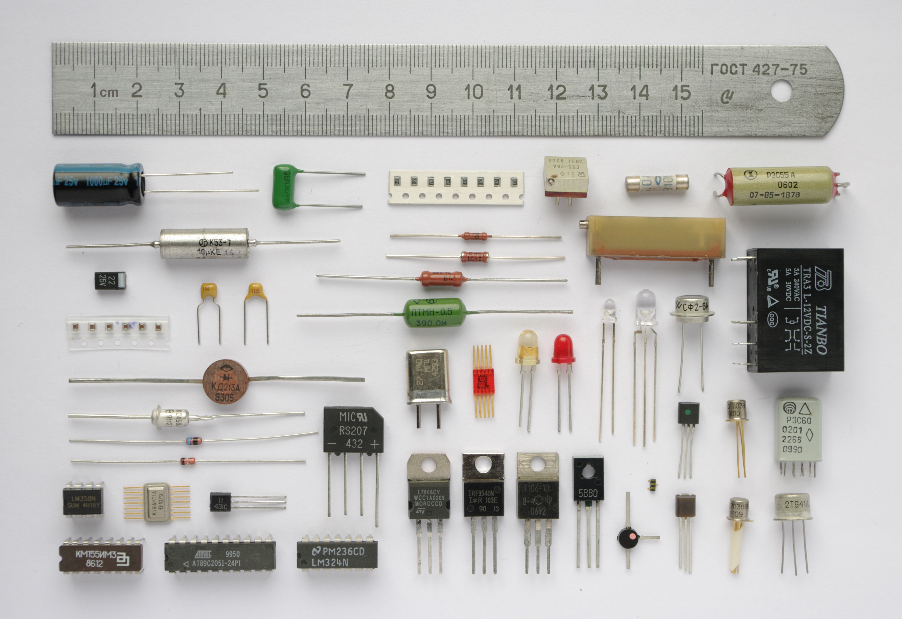
2|
PCB technologies
Description
Description :
Through Hole Technology (THT) represents all the electronic components that need to go trough the board to be solder. Most of the components have a THT type, they are the easiest way to make a PCB.

Slide 16
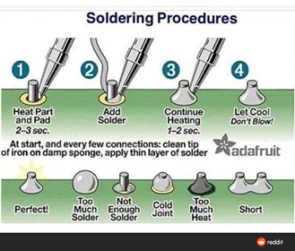
2|
PCB technologies
Soldering
Tips :
One of the most important tips is the most simple and difficult, be patient! Generally, if it doesn’t work, it is because one of the parts you try to solder didn’t have time to warm up, or because your soldering tool is dirty.

Slide 17
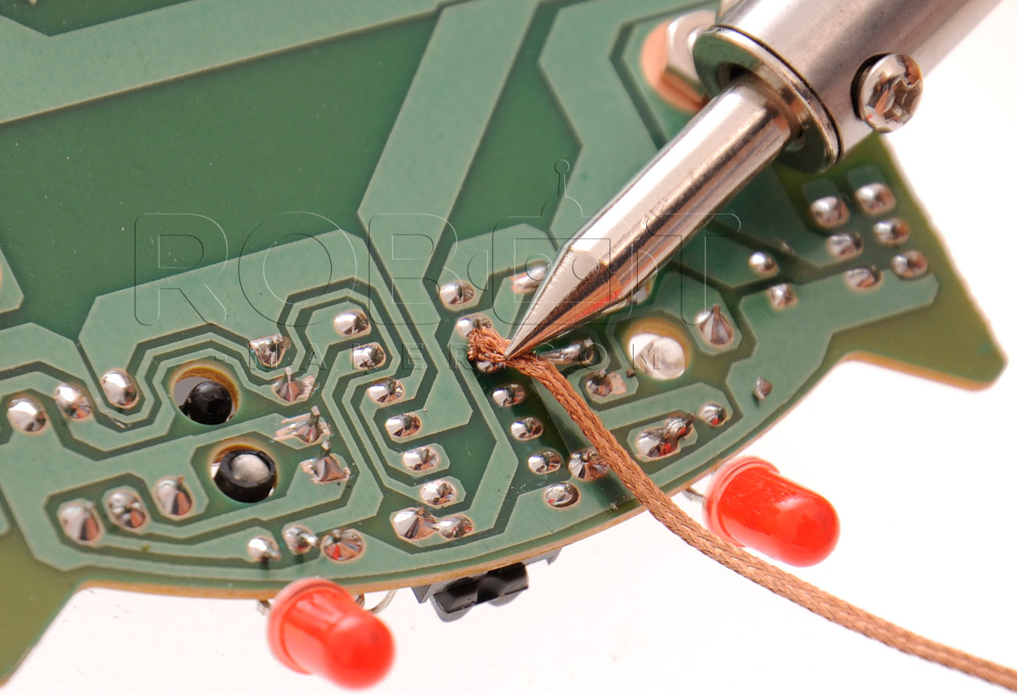
2|
PCB technologies
Desoldering
Tips :
Do not hesitate to use flux and desoldering bread. One of the most important tips is the most simple and difficult, be patient!

Slide 18
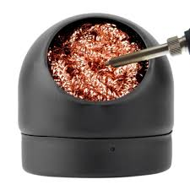
2|
PCB technologies
Cleaning
Tips :
Cleaning the iron solder is extremely important. The oxidation from the heat make it dirty, you need to use solder to clean it. If it doesn’t work, use a sharp tool and scratch it. BE CAUTIOUS, THIS PROCESS DESTROY THE IRON SOLDER.

Slide 19
2|
PCB technologies
SMD
Description
Soldering
Desoldering
Cleaning

Slide 20
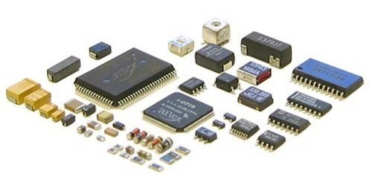
2|
PCB technologies
Description
Definition :
Surface Mounted Devices (SMD) refers to electronic components that can be solder on one surface of a PCB. Most of the components can be found in this shape, especially integrated circuits (IC). Take care of them, they are fragile.

Slide 21
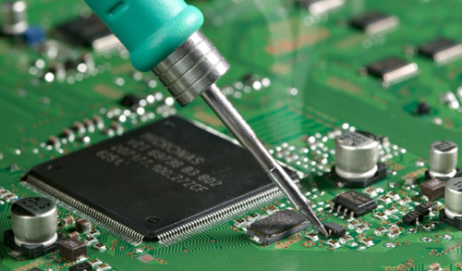
2|
PCB technologies
Soldering
Tips :
SMD have different leg sizes. Some of them are tedious or impossible to solder with an iron solder. You need to use an oven for it. The solder paste use needs to have a specific warming cycle to solder properly, take care of the solder you are using.

Slide 22
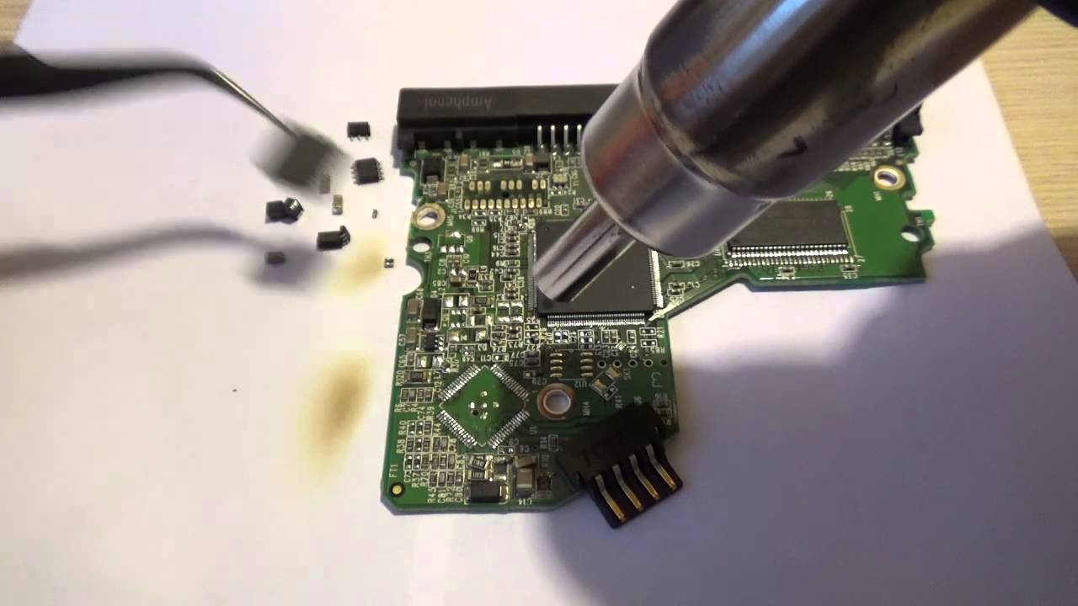
2|
PCB technologies
Desoldering
Tips :
SMD desoldering isn’t a perfect process. Most of the time, we don’t salvage SMD parts because their desoldering damage them. If you wish to do it, anyway, doesn’t hesitate to use flux and learn to use a hot air desoldering

Slide 23
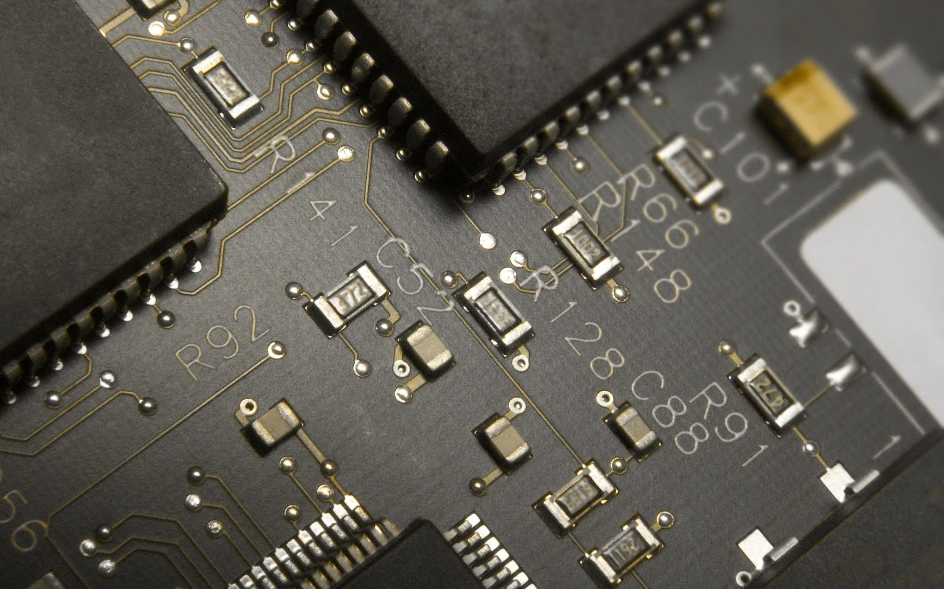
Circuit design
Integrated circuit (IC)
Manufacturing design

Slide 24
3|
Digital electronic
Integrated circuit (IC)
History
Manufacturing
Datasheet

Slide 25
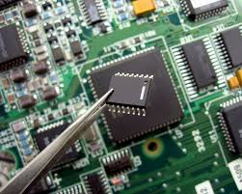
3|
Digital electronic
History
Definition :
An integrated circuit (IC) is a component that contains a specific circuit inside. It was first demonstrated by Jack Kilby in 1958, then upgraded and developed for massive production in 1959 by Giggle Byte. Each IC is made from silicon, a mineral component that represents a quarter of the earth’s crust. In the middle of 1960, an IC contains hundreds of transistors. Today, an IC 1x1cm can contain several billion transistors.

Slide 26
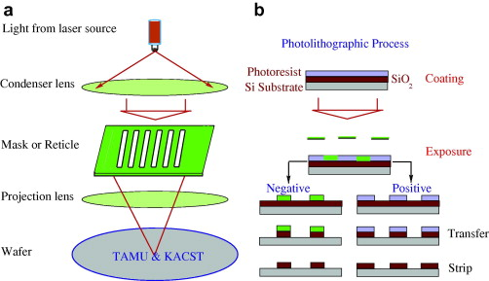
3|
Digital electronic
Manufacturing
Definition :
Photolithography is a process used in microfabrication, especially for IC. It uses light to transfer a geometric pattern from a photomask to a photosensitive chemical on the substrate. A series of chemical treatments expose the pattern and enables the deposition of new material in the desired pattern upon the material underneath the photoresist. For the more complex IC, the wafer may go through the photolithographic cycle as many as 50 times.

Slide 27
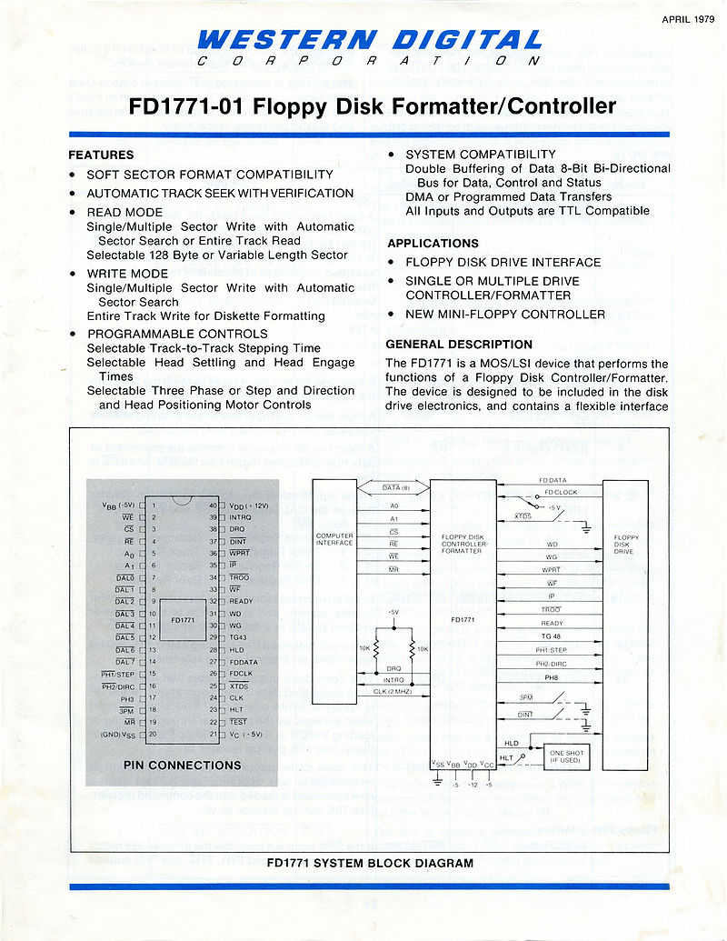
3|
Digital electronic
Datasheet
Definition :
A datasheet is a document that summarizes the performance and other characteristics of a product, machine, component, etc...
In electronic, each IC comes with a datasheet. If you have a question about the component, the answer is inside the datasheet.

Slide 28
3|
Digital electronic
Manufacturing design
Upverter
ATmega328

Slide 29
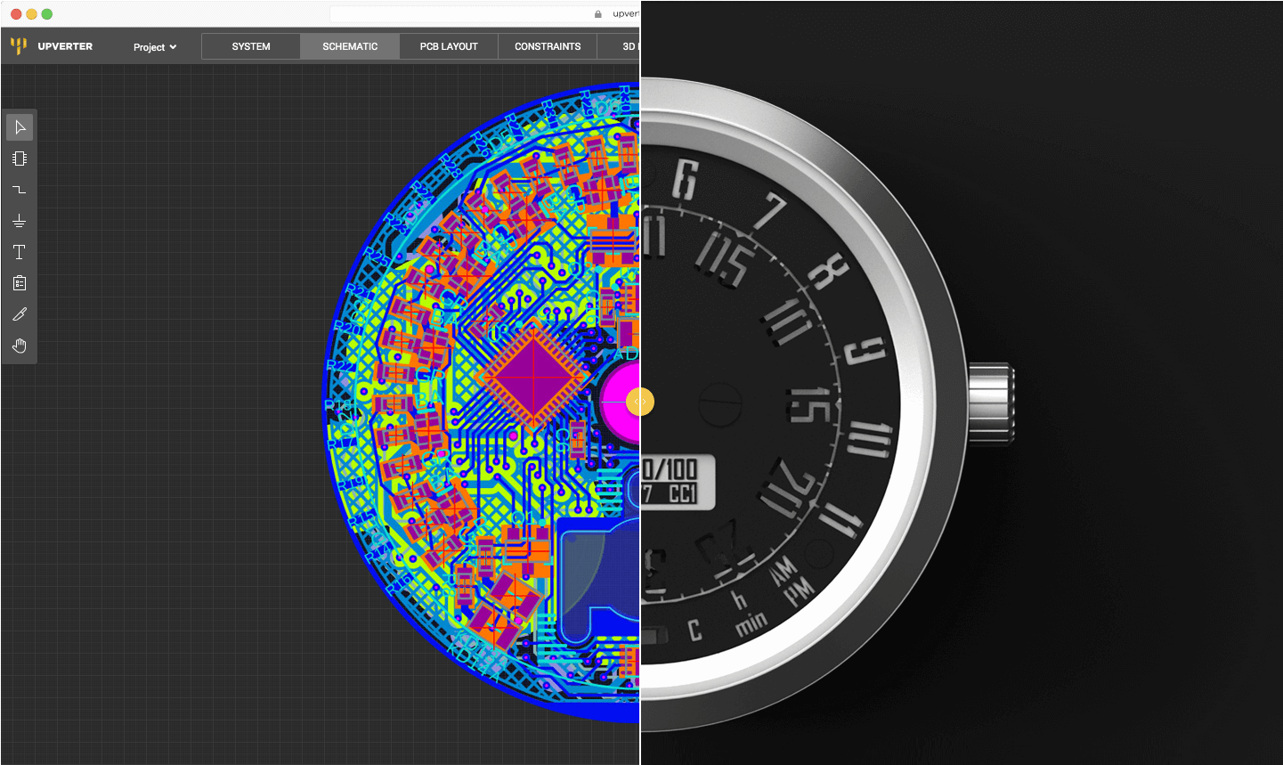
3|
Digital electronic
Upverter
1) Go on internet
2) Go on upverter.com
3) Create an account
4) Let’s make a PCB

Slide 30
3|
Digital electronic
ATmega328
1) Create a circuit with an atmega328, don’t forget the external clock and resistors
2) Add a multiplexer with Leds
3) Add a multiplexer with logic gates to create an external adder 4-bit
4) Don’t forget the connectors and power stage ;)

